Slide 1
Introduction to SS7
Konrad Hammel
Sangoma Technologies

Slide 2
What is SS7?
Signaling System 7
  CCSS7, C7, number 7, CCIS7
Official Standard by ITU in 1980
Common Channel Signaling (CCS)
  Signaling channel, CICs
2 versions…ITU and ANSI
Universal signaling via a suite of sub-protocols
  ISUP, TUP, DUP, etc

Slide 3
SS7 Network Elements
3 types of Switches
Signal Switching Points (SSP)
  Terminate signaling links
  Start, end, and switch calls
Signal Transfer Points (STP)
  Main routing switches
Signal Control Points (SCP)
  Switches attached to Databases

Slide 4
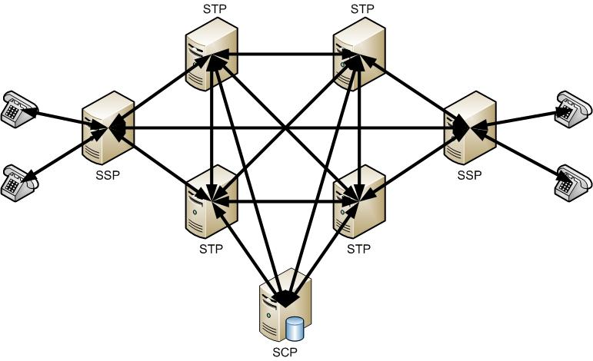
SS7 Network Elements

Slide 5
SS7 Link Types
A Links
  Link between an end point and an STP
  “A” stands for Access
  Purpose is to deliver signaling messages
  Connects an SSP to an STP
  Connects an SCP to an STP
C Link
  Link between 2 STPs (making them a “mated” pair)
  “C” stands for Cross Link

Slide 6
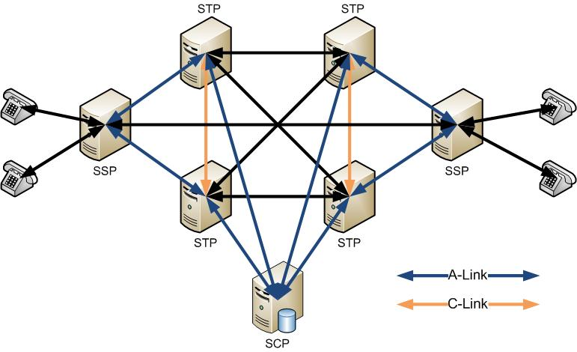
SS7 Link Types

Slide 7
SS7 Link Types
B Links
  Link between 2 mated STP pairs
  “B” stands for Bridge Link
D Links
  Link between 2 mated STP pairs (different hierarchical levels)
  “D” stands for Diagonal Link

Slide 8
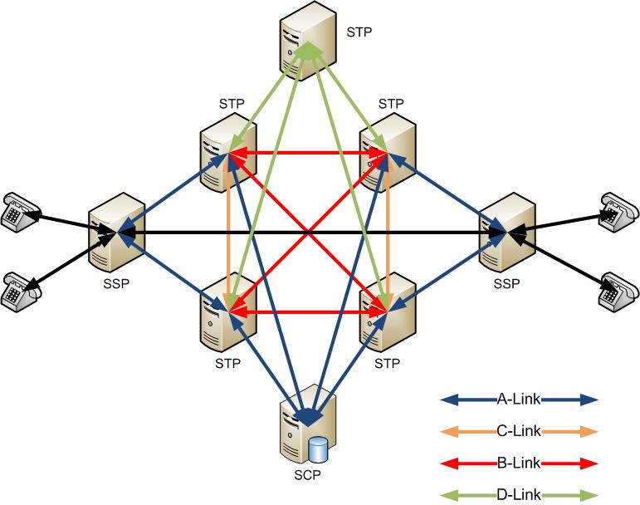
SS7 Link Types

Slide 9
SS7 Link Types
E Links
  Link between an SSP and a secondary mated STP
  “E” stands for Extended Link
F Links
  Link between 2 SSPs
  “F” stands for Fully Associated

Slide 10
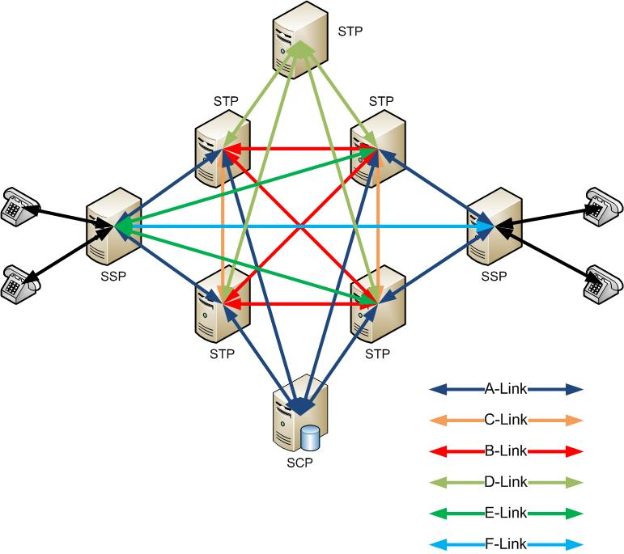
SS7 Link Types

Slide 11
SS7 Stack layers
ISUP
MAP/INAP
Application
TCAP
Presentation
Transport
Session
SCCP
MTP3
Network
MTP2
Data Link
MTP1
Physical

Slide 12
MTP Layers
MTP2
MTP3
Data Link Layer Protocol
Ensures reliable communications on a signaling link
  Error checking, flow control, and sequence checking
Defined in ITU Q.702, Q.703. ANSI equivalents exist
Network Layer Protocol
Ensures reliable communications to other nodes in the network
  Addressing, routing, and congestion control
Defined in ITU Q.703, Q.704. ANSI equivalents exist

Slide 13
MTP2 Messages
BSN/BIB
7 bits/1 bit
FSN/FIB
7 bits/1 bit
LI/Spare
6 bits/2bits
CRC
16 bits
FISU – Fill In Signal Unit
BSN/BIB
7 bits/1 bit
FSN/FIB
7 bits/1 bit
LI/Spare
6 bits/2bit
SF
8/16 bits
CRC
16 bits
LSSU – Link Status Signal Unit
BSN/BIB
7 bits/1 bit
FSN/FIB
7 bits/1 bit
LI/Spare
6 bits/2bits
SIO
8 bits
SIF
>=24 bits
CRC
16 bits
MSU– Message Signal Unit

Slide 14
MTP Messages - Continued
BSN
  Backwards Sequence Number
  Increments to acknowledge reception of a valid frame
BIB
  Backward Indicator Bit
  Toggles to indicate negative acknowledgement of the last frame
FSN
  Forward Sequence Number
  Increments to indicated transmission of a valid frame
FIB
  Forward Indicator Bit
  Toggles to indicate the beginning of retransmission

Slide 15
MTP Messages - Continued
LI
  Length Indicator
  0 = FISU, 1-2 = LSSU, >2 = MSU
SF
  Status Field
  Indicates state of link alignment
SIO
  Service Information Octet
  Indicates type of layer 4 frame
SIF
  Service Information Field
  Layer 4 data

Slide 16
FISU Frames
Used to idle the signaling link and keep track of transmitted and received frames
Even though HDLC framing is used on signaling linking frames; MTP does not allow for more then 2-3 idle flags to be transmitted, instead FISU frames are transmitted repeatedly

Slide 17
LSSU Frames
Used to sync the state machines on both sides of the link
Frame length can be 1 or 2 (normally 1 and normally switches are supposed to be compatible with both)
6 types of frames identified by the value of the status field (Status Indication X)
Service Information Octet (ITU Q.703, 11.1.3, page 23):
  0, SIO, “out of alignment”
  1, SIN, “normal alignment”
  2, SIE, “emergency alignment”
  3, SIOS, “out of service”
  4, SIPO, “processor outage”
  5, SIB, “busy”

Slide 18
MSU Frames
Used to carry higher layer traffic (MTP3 mng/test, ISUP, SCCP frames)
Service Information Field divides into 2 fields:
  Sub-Service Field, type of layer 4 traffic
  Service Indicator, network indicator (aka NI)
Service Indicator(ITU Q.704, 14.2.1, page 70):
  0, network management messages
  1, network test messages
  3, SCCP
  5, ISUP
Sub-Service Field (ITU Q.704, 14.2.2, page 71):
  0, International Network
  1, Spare (international use only)
  2, National Network
  4, Reserved for national use

Slide 19
MTP2 State Machine
ITU Q.703, Figure 4, page 18

Slide 20
Important MTP terms
SUERM/AERM
  Signal Unit/Alignment Error Rate Monitor
PCR
  Preventive Cycle Retransmission Error Correction
BASIC
  Basic Error Correction
SLTM/SLTA
  Signal Link Test Message/Acknowledge
POC
  Processor Outage
IAC
  Initial Alignment Control
LSC
  Link State Control

Slide 21
Thank you.

