Slide 1
Scaling Asterisk TDM Architecture
AAUG Install Fest 2009
Konrad Hammel
Sangoma Technologies

Slide 2
Outline
Introduction
  Who/what is Sangoma?
Why do we need to scale?
  32 E1s +
Dahdi/Asterisk Architecture Overview
Short Comings of Current Architecture
  Dahdi does A LOT
  TDM Hardware Restrictions
  Singular System Design
Sangoma’s Solution
  TDM Voice API + SMG + Chan_Woomera
  Stage 1
  Stage 2
  Stage 3

Slide 3
Introduction
Who is Sangoma?
  Founded in 1984
  Publically traded on the Toronto Stock Exchange
  Currently 25 employees (and growing)
  Located in Markham (Greater Toronto Area), Ontario, Canada
  David Mandelstam, Founder and CEO

Slide 4
Introduction
What does Sangoma do?
  We design and built interface cards
  Industry leading cards, professional quality using industrial grade components
  Software to maximize the use of our cards
    Sangoma started Linux Based Routers
      October 1993 -> Certification of FR with MCI
      April 1994 -> WAN cards to Rockwell for router project
      December 1996 -> Wanpipe Frame Relay for Linux
      First version of Asterisk used Sangoma Frame Relay card
    Support for different protocols in Linux
    Our drivers are still there.

Slide 5
Why Do We Need to Scale?
Asterisk is SOLID!
Demand for 16+ E1s
  SS7 systems are leading the push
Multiple Asterisk boxes are hard to maintain

Slide 6
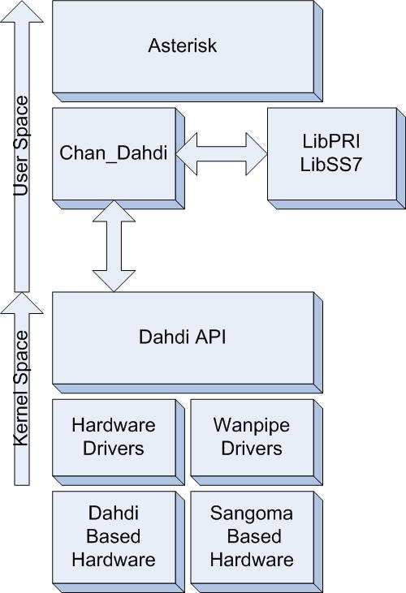
Dahdi/Asterisk Architecture
Dahdi API abstracts TDM hardware from User space apps
Dahdi takes care of DTMF, HDLC framing, echo cancelling, some DSP processing, some signaling (analog, E&M,etc)
Chan_Dahdi takes care of interfacing to Asterisk and some signaling

Slide 7
Dahdi Does ALOT
Dahdi by default does:
  Echo Cancelling
  HDLC Framing
  DSP Processing (DTMF, Fax dection)
Why…?
  Software is cheaper then hardware
Solution…Move it to hardware
  Hardware EC
  Hardware HDLC
  Hardware DTMF
  Hardware Fax Dection
  FPGAs and DSPs are cheap and efficient

Slide 8
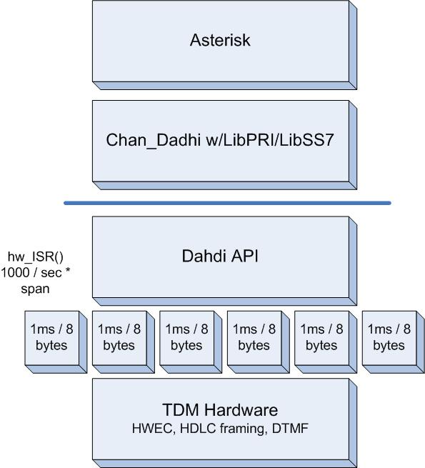
TDM Hardware Restrictions
Dahdi requires 1ms (8 bytes) of data on each interrupt…1000 interrupts/sec
1 interrupt / port
Lots of interrupts
Solution:
  Design hardware so that 1 interrupt services multiple ports (1 interrupt / card)
  Increase Dahdi’s chunk size (8,16,40 and 80)
Current Status:
  Global interrupt since firmware 23
  ./Setup install –zaptel-chunk=X

Slide 9
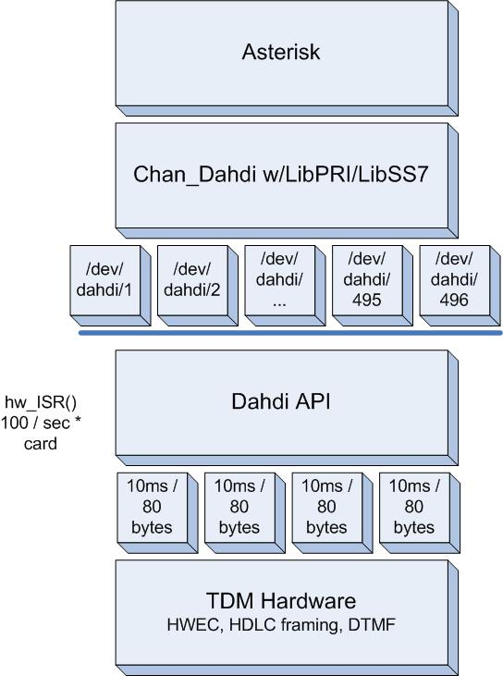
TDM Hardware Restrictions
Dahdi creates a device for each channel
  User application is simple…direct feed to soft-switch
16 ports = 496 devices
  Linux only recently able to handle
Solution:
  Abstraction API creates a device/span
  User application decodes the span into channels
Requires a major change to Dahdi and Chan_Dahdi

Slide 10
Singular System Design
Dahdi and Chan_Dahdi are designed to run on the same system as Asterisk
What about:
  Distributed Computing
  Load Balancing
  Redundancy
Solution:
  Redesign Dahdi and Chan_Dahdi so that they can be run on different systems, be able to communicate with multiple instances, and load balance between multiple instances

Slide 11
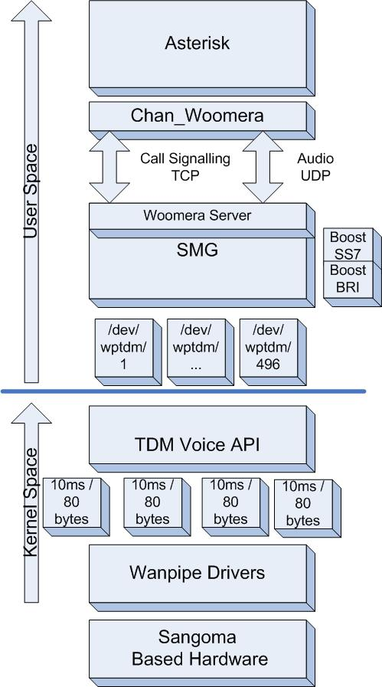
Sangoma’s Solution Stage 1
Dahdi is replaced with TDM Voice API
Chan_Dahdi is replaced with SMG and Chan_Woomera
Sangoma Media Gateway
  Uses “Boost” stacks
  Woomera Server
Chan_Woomera
  Socket Based Communication to Woomera Server
  Simple text based call signaling protocol
  Ulaw or Alaw

Slide 12
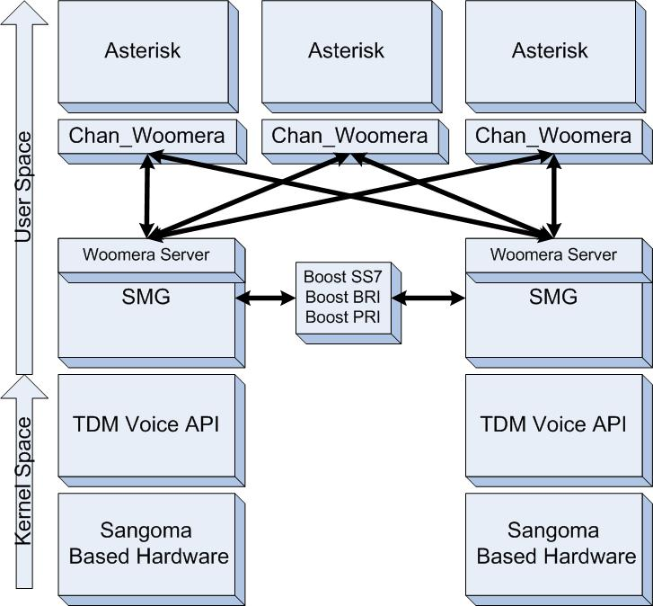
Sangoma’s Solution Stage 2
Chan_Woomera
  Distributed Computing
  Load Balancing
  Redundant
Boost Stacks are Clustered
  1 stack for multiple media gateways
Currently being deployed using 16 E1s per system

Slide 13
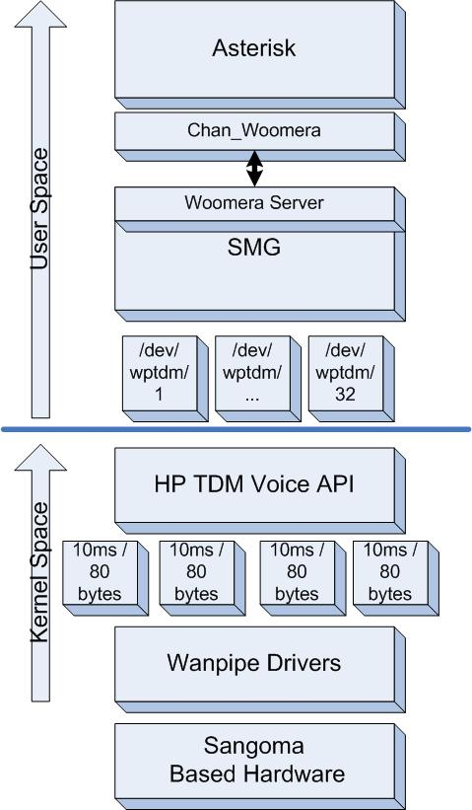
Sangoma’s Solution Stage 3
TDM Voice API is replaced with High Performance TDM Voice API
  Span Based devices
  SMG decodes the channels
Currently being tested in our labs
  32 E1s, Q6600 Quad Core, 992 channels used, 2-5% with spike to 10% system load

Slide 14
Thank you.
Konrad Hammel
Sangoma Technologies

