Slide 1
Achieving optimal scalability and voice quality in open source telephony
Konrad Hammel
Software Engineer
Sangoma Technologies

Slide 2
What is the Secret to scalability and quality?

Slide 3
Using The best hardware and the best software

Slide 4
Outline
Sangoma Hardware
AFT-Series
B-Series
Other Hardware
Intro to Asterisk Architecture
Bottlenecks and Scalability Issues
Everything in Software
Chunk Size restriction of Dahdi
Channel Based
Monolithic Design
FreeTDM + SMG + SIP/Woomera
Questions???

Slide 5
Sangoma Hardware

Slide 6
AFT Series
Advanced Flexible Telephony
Award winning design from scratch
OOP Design
Modular -> PCI/PCIe interface, telephony interface, DSP
Abstraction -> common base, Remora system
Higher per card cost but lower maintenance and easier to stock

Slide 7
AFT Series - Continued

Slide 8
AFT Series - Features
Octasic HWEC
Industry’s 1st telco grade HWEC
Adjustable 128ms tail
Fully Independent…no fine tuning needed
Fax/Modem and DTMF detection
Field Upgradable Firmware
Fix bugs and add new features on the fly
Crash Proof Firmware
Recover the card after “act of god” accidents
Industry first and only LIFETIME WARRANTY

Slide 9
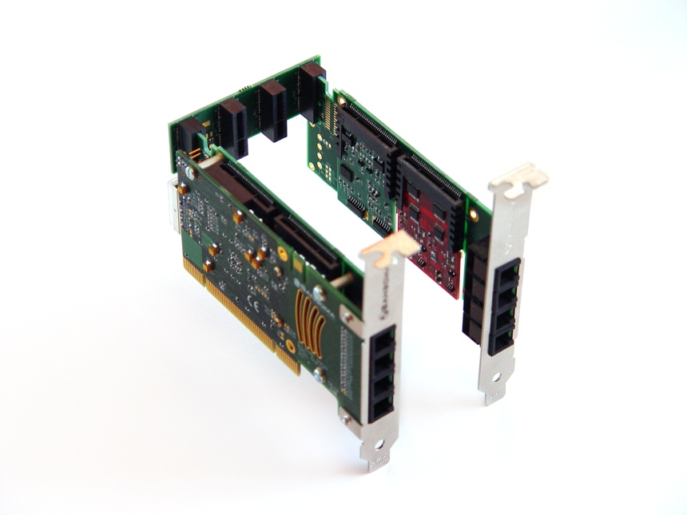
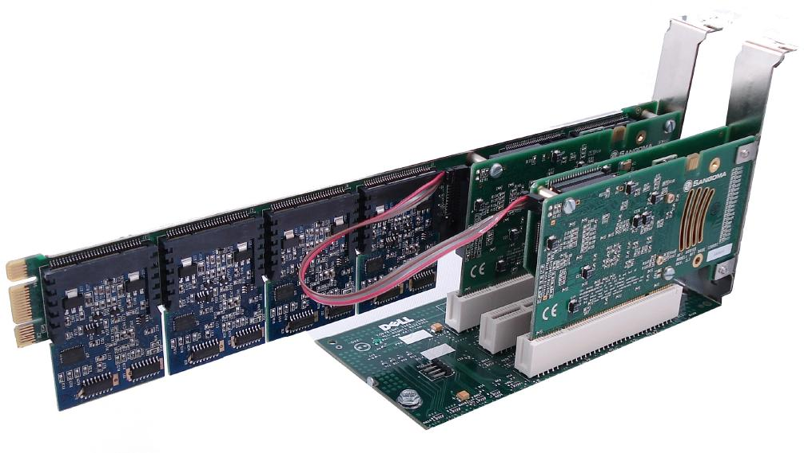
AFT Series - Features
Fax Sync
Remora Expansion System
Reliable T1/E1/BRI to analog faxing
Syncs clock from digital to analog card
Add more telephony ports without using PCI/PCIe slots
Up to 24 ports per card

Slide 10
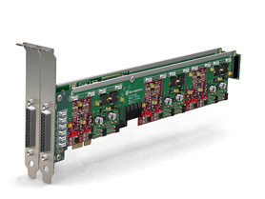
AFT Series - Analog
A200
Low density modular
2-24 port FXO/FXS
2u, PCI/PCIe(E), half-length
Optional HWEC (D)
A400
High density modular
2-24 port FXO/FXS
2u, PCI/PCIe(E), full length
Optional HWEC (D)

Slide 11
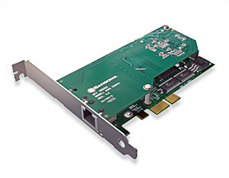
AFT Series – Digital T1/E1
A10X line
A101, A102, A104, and A108
2-8 T1/E1/J1 ports
Channelized for voice and data
2u, PCI/PCIe (E) half-length
Optional HWEC (D)

Slide 12
AFT Series – Digital BRI
A500
2-6 port modular BRI, up to 24 with Remora
2u, PCI/PCIe (E), half-length
Optional HWEC (D)

Slide 13
B-Series – Mix Mode
B700
Modular BRI and analog
2-4 BRI, 2 FXO/FXS
2u, PCI/PCIe(E) half-length
Optional HWEC (D)
5 year warranty

Slide 14
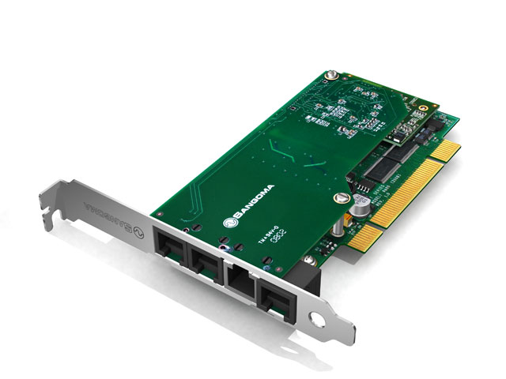
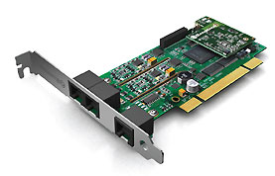
B-Series – Mix Mode
B600
B601D
4 FXO ports, 1 FXS port
2u, PCI/PCIe, half-length
Optional HWEC (D)
5 year warranty
4 FXO, 1 FXS, 1 T1/E1/J1
2u PCI/PCIe , half-length
Comes with HWEC
5 year warranty

Slide 15
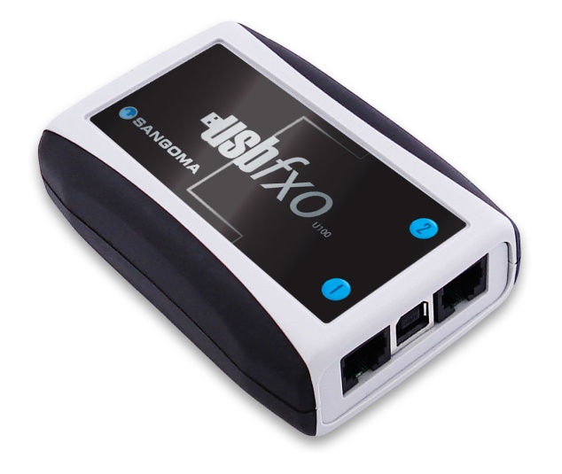
Other Hardware
U100 (USBFXO)
UT-50/UT-51
2 port FXO interface via USB
Comes with HWEC
5 year warranty
Asterisk timing device
USB (UT-50) and internal pin header (UT-51) interface
5 year warranty

Slide 16
Introduction to Asterisk Architecture

Slide 17
Asterisk Architecture
Asterisk Core
Channel Drivers like Chan_SIP and Chan_Dahdi
Action Plan (dial plan)
Dahdi API
Hardware Drivers
Hardware
User Space
Kernel Space
Dial plan
Asterisk Core
Chan_Dahdi
libPRI
Dahdi API
DTMF
analog
SWEC
HDLC
Wanpipe
Hardware (A10X, A200, B601, etc)

Slide 18
Bottlenecks and scalability issues

Slide 19
Software Everything
HDLC encoding
Easy but still takes processing power
Very simple to do in FPGA based hardware
Echo Cancelling
Extremely CPU intensive…complicated math
Audio glitches when not perfect
DSP designed to do math
DTMF Detection
Like EC can be CPU intensive because it is math based
Hardware EC DSP can easily take care of this

Slide 20
Chunk Size
Dahdi takes 1ms = 8 bytes
1000 interrupts per second!
WHY???
Analog signaling
Software EC
Software DSP
SOLUTION: Increase to 20ms chunks optimal for system performance (up to 70% less CPU load)
How to Reduce Asterisk System load by 70%
Dahdi API
8 bytes
1ms
8 bytes
1ms
…..….
8 bytes
1ms
Hardware/Wanpipe
A101 – 1 E1/PRI

Slide 21
Channel Based
PROBLEM: Channel Based API
Each voice channel gets a kernel device
Easy for user space…
16 E1 ports = 496 devices
HUGE amount of context switches
SOLUTIONS: Span Based API
Each span gets a device
A little more work in user space
Much less work done in time dependent kernel

Slide 22
Monolithic Design
PROBLEM: Dahdi, Chan_Dahdi, and Asterisk are linked directly
If one fails, the whole system fails
All load concentrate on one system
SOLUTION: Woomera or SIP
Socket based connection to Asterisk
A crash on one side does not kill the other side
Client-Server Architecture
Allows for 1-to-Many connections (load balancing)
Asterisk registers into PSTN interface

Slide 23
FreeTDM + SMG + Woomera/SIP

Slide 24
FreeTDM + SMG + SIP
High Quality Sangoma Hardware
Wanpipe Kernel drivers
TDM API
FreeTDM + Sig stacks
SMG
Chan_SIP or Chan_Woomera
Asterisk Cores
User vs. Kernel Space
Asterisk
Asterisk
Chan _SIP
Chan _Woomera
SMG
FreeTDM
PRI/BRI
SS7
analog
TDM API (20ms chunks)
Wanpipe
Sangoma Hardware
HW-HDLC, HWEC, HW-DTMF

Slide 25
Kernel Space
Sangoma Hardware
TDM API
Telco grade quality
Hardware HDLC framing
Hardware Echo Canceling
Hardware DTMF Detection
Small, Open Source, kernel based API
Runs at 20ms chunks
Can run in channel mode or span mode
No processing of any kind…just passes data
OS independent

Slide 26
FreeTDM
Open Source, User space, C based TDM/PSTN API
Span based or Channel based
Unified..handles voice and signaling
PRI, BRI, SS7, analog
DTMF detection and generation
Caller-id detection and generation
Complete hardware abstraction allows any hardware to run
“plug and play” stacks (open source and proprietary)
Operating system independent: Linux and Windows

Slide 27
SMG
Sangoma Media Gateway
Open Source (always has been, always will be)
Connects to FreeTDM and uses the FS core to access SIP or Woomera , transcoding (HW or SW), logging (unified hardware, TDM, stack logging), and a web front end interface
Asterisk Channel bridging, SMG-to-SMG bridging
OS independent: Linux and Windows

Slide 28
Conclusion
Voice quality in Asterisk can be improved by:
Using telco grade hardware
Using telco grade HWEC
Optimizing for system load
Asterisk scalability is achieved by:
Moving processor intensive tasks to hardware
Reducing system load by increasing data chunk size
Using a distributed architecture
Asterisk
Asterisk
Chan _SIP
Chan _Woomera
SMG
FreeTDM
PRI/BRI
SS7
analog
TDM API (20ms chunks)
Wanpipe
Sangoma Hardware
HW-HDLC, HWEC, HW-DTMF

Slide 29
Questions?

Slide 30
Thank you Come visit us at Booth A4

