Slide 1
Introduction to SS7
Konrad Hammel
Sangoma Technologies

Slide 2
Outline
What is SS7?
SS7 Network Elements
  SCP, STP, and SSP
SS7 Link Types
  A,B,C,D,E, and F links
Basic Call Messages
  IAM, ACM, ANM, REL, and RLC
SS7 Signaling Stack
  MTP1, MTP2, MTP3, ISUP, and others
SS7 Signaling Messages
  FISU, LSSU, and MSUs
SS7 Addressing
  SPC, DPC, and APC

Slide 3
What is SS7?
Signaling System 7
  CCSS7, C7, number 7, CCIS7
Official Standard by ITU in 1980
Common Channel Signaling (CCS)
  Signaling channel, CICs
2 versions…ITU and ANSI
Universal signaling via a suite of sub-protocols
  ISUP, TUP, DUP, etc

Slide 4
SS7 Network Elements
3 types of Switches
Signal Switching Points (SSP)
  Terminate signaling links
  Start, end, and switch calls
Signal Transfer Points (STP)
  Main routing switches
Signal Control Points (SCP)
  Switches attached to Databases

Slide 5
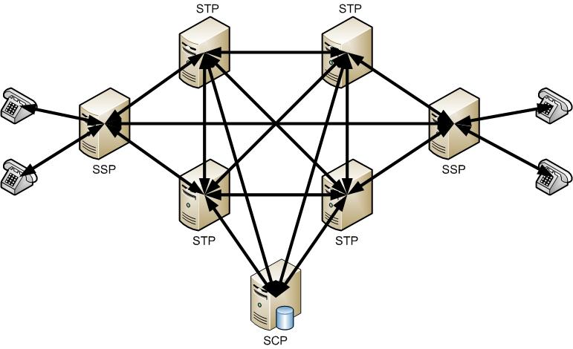
SS7 Network Elements

Slide 6
SS7 Link Types
A Links
  Link between to end-points
  “A” stands for Access
  Purpose is to deliver signaling messages
  Connects an SSP to an STP
  Connects an SCP to an STP
C Link
  Link between 2 STPs (making them a “mated” pair)
  “C” stands for Cross Link

Slide 7
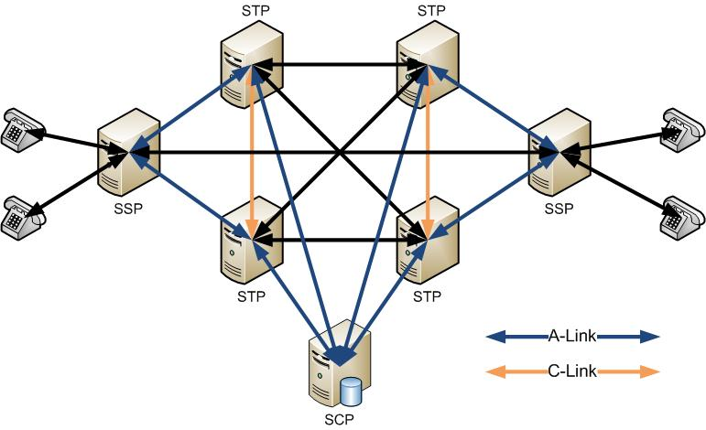
SS7 Link Types

Slide 8
SS7 Link Types
B Links
  Link between 2 mated STP pairs
  “B” stands for Bridge Link
D Links
  Link between 2 mated STP pairs (different hierarchical levels)
  “D” stands for Diagonal Link

Slide 9
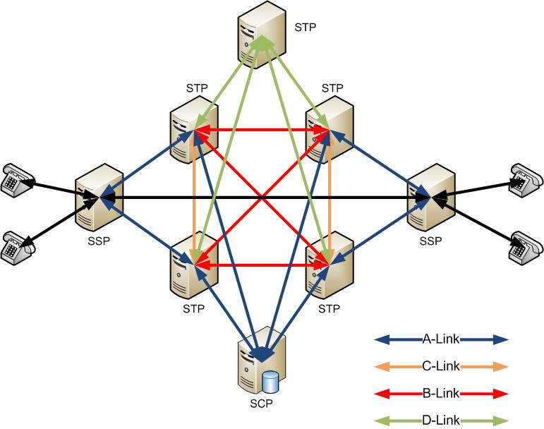
SS7 Link Types

Slide 10
SS7 Link Types
E Links
  Link between an SSP and a secondary mated STP
  “E” stands for Extended Link
F Links
  Link between 2 SSPs
  “F” stands for Fully Associated

Slide 11
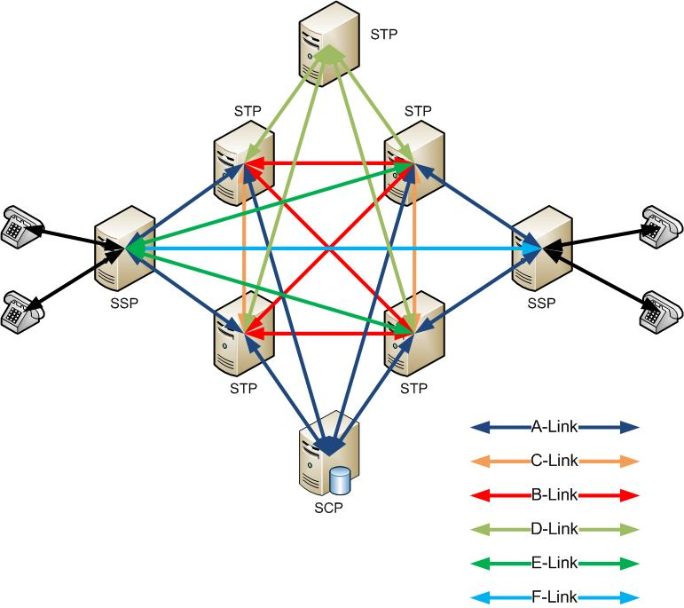
SS7 Link Types

Slide 12
Basic Call Messages
5 Basic messages to establish a connected between 2 end points
IAM
  Initial Address Message
  Requests the call/connection
ACM
  Address Complete Message
  Confirms reception of IAM
ANM
  Answer Message
  Confirms the route of the voice (which CICs to use)
REL
  Release Message
  Requests an end to the call
RLC
  Release Complete Message
  Confirms the end of the call

Slide 13
SS7 Signaling Stack
MTP1
  Physical layer
  DS-0 channel (56k or 64bit)
MTP2
  Data Link Layer
  Ensures reliable transmission
  Error checking, flow control, and sequence checking
MTP3
  Network Link Layer
  Ensures message delivery in the network
  Addressing, routing, and congestion control
ISUP
  Application Layer
  Protocol that establishes calls between 2 end points
  Call setup, call information, and call tear down

Slide 14
SS7 Signaling Messages
3 type of messages
FISU
  Fill In Signal Units
  MTP2
  Sequence checking, error checking, and line filler
LSSU
  Link Status Signal Units
  MTP2
  Signaling status messages
  Used to “align” or “sync” two points
MSU
  Message Signal Units
  MTP3
  Carry all messages between points

Slide 15
SS7 Addressing
3 types of addresses
2 different styles of addresses
  ITU -> Decimal Number…1234
  ANSI -> Network-Cluster-Member…. 1-2-3
SPC
  Self Point Code
  The address of the local system
APC
  Adjacent Point Code
  Address of system on the other end of the signaling link
DPC
  Destination Point Code
  Address of system that controls the voice CICs

Slide 16
Thank you.

