Slide 1
Introduction to SMG-SS7
Konrad Hammel
Sangoma Technologies

Slide 2
Outline
SMG-SS7 Asterisk Architecture
Wanpipe/TDM Voice API
Ss7boxd
Ss7boost
Sangoma Media Gateway
Chan_Woomera

Slide 3
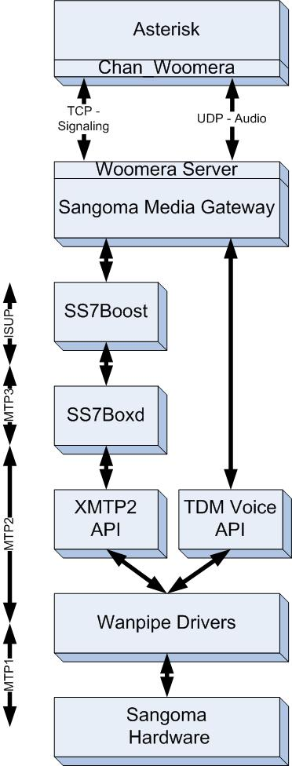
SMG-SS7 Architecture

Slide 4
Wanpipe/TDM Voice API/XMTP2 API
Wanpipe
  Hardware drivers that control data flow from hardware to kernel space
TDM Voice API
  Sangoma’s API that allows user space access to voice channels
XMTP2 API
  Open source kernel space API that controls the flow of MTP2 messages

Slide 5
SS7Boxd and SS7boost
SS7boxd
SS7Boost
Daemon that controls the XMTP2 API
Configures and Controls the SS7 signaling links
Establishes MTP2 and MTP3 Connections
Daemon that handles ISUP
Aware of Voice CICs and their location
Handles call SS7 call generation and reception

Slide 6
Sangoma Media Gateway
Go between SS7 and soft-switch
Controls flow of voice channels
Handles DSP functions
Communicates to SS7boost through the “Boost” protocol
Communicates to soft-switch via an Woomera Server

Slide 7
Chan_Woomera
Asterisk Channel driver (Woomera Client)
Uses TCP ports for signaling and UDP ports for audio
Very simple Text based protocol
Audio is encoded in U-law or A-law
Forwards and Backwards Compatible
Load balancing and distributed computing

Slide 8
Thank you.

